Slide 1
TDDD63 - Perspectives in Computer Science and Computer Engineering
Adam Andersson
Aleksi Evansson
Ludvig Westerdahl

Slide 2
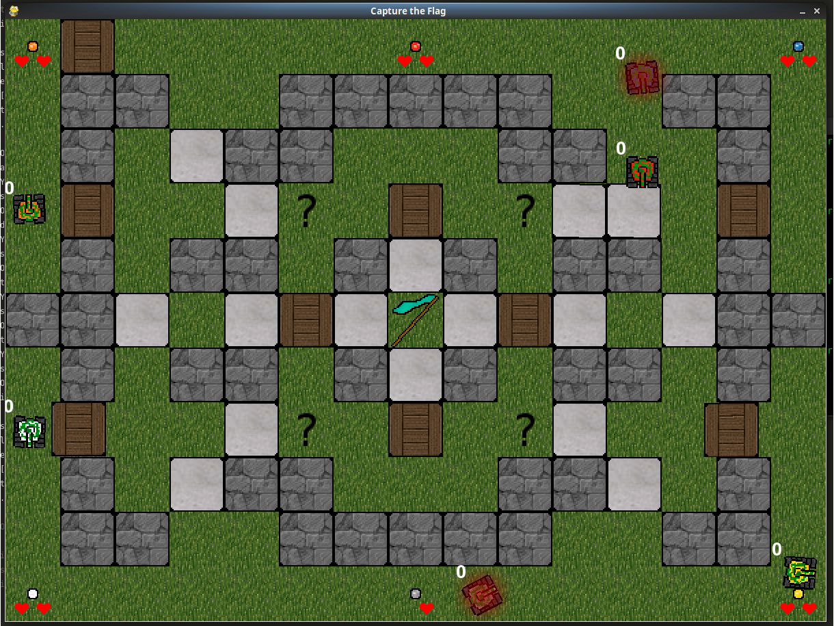
Capture the flag

Slide 3
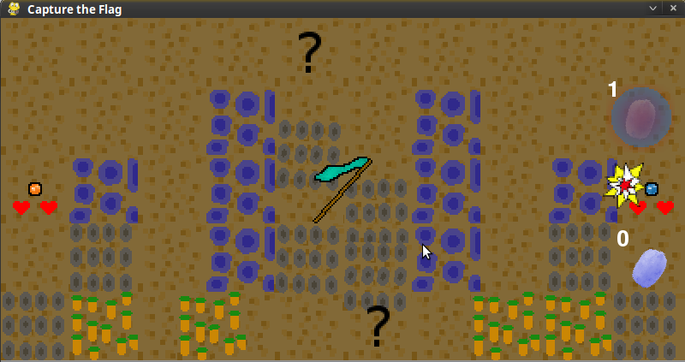
Features
Menus
Maps
Art
Multiplayer

Slide 4
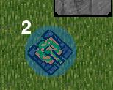
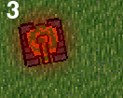
Features
Portals
Spawn protection
Overheat

Slide 5
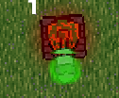
Features
Powerups
Increased or reduced speed
Increased damage
Sticky ammunition
Shield

